Slide 1
Basic OOP in C#

Slide 2
Agenda
Abstraction
Encapsulation
Inheritance
Polymorphism
Abstract Class & Interface

Slide 3
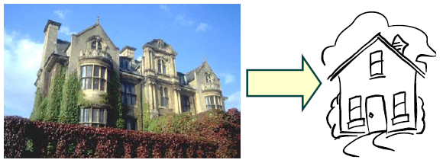
Abstraction
The art of being wise is the art of knowing what to overlook William James
Reduce complexity by focusing on the essentials relative to perspective of viewer
Notes:
Các bài toán chúng ta phải giải quyết ngày càng phức tạp. Chính vì thế chúng ta cần có kỹ thuật để giảm mức độ phức tạp mà chúng ta cần phải xem xet giải quyết tại một thời điểm.
Thời gian để chúng ta hiểu tỉ lê nghịch với số lượng thông tin mà chúng ta phải xử lý
Knowing what to overlook ➔ Reduce the amount of facts that we have to deal with simultaneously.
Example 1: bac sy xem cac thong tin ve benh nhan, tieu su. Ho tranh nhung khong tin khong can thiet, khong lien quan de tim ra nguyen nhan nhanh chong nhat
Example 2: Voi cung mot doi tuong: BOOK, thi cac thong tin can quan tam se khac nhau:
- Library System: Quan tâm tới Access Number, Book name, Author Name, year of publication …
- Book Store: Item number, Item name, Price, Quantity in stock …
Chỉ quan tâm tới những thông tin quan trọng, cần thiết để giải quyết bai toan

Slide 4

Abstraction Sample 1/2
Object: Sport Car
Data: Information
Wheel: 4 wheels
Main color: Orange
Rear port: 2 ports
With upper window: Yes
Seat: 2 seats
Cylinder volume:2.1L
Action
Engine start
Speed up, Slow down
Turn left, turn right
Stop

Slide 5

Abstraction Sample 2/2
Car is described by:
Number of wheels
Main color
Number of rear port
With upper window or not
Number of seats
Cylinder volume
Engine start
Speed up
Slow down
Turn left
Turn right
Engine Stop
Each car has its out data and actions

Slide 6



Abstraction What is an object?
Represent an entity in the “real” world
Possesses operation (behavior) and attributes (data – state)
Data ➔ contain information describe
the state of objects
Operation/Behavior ➔ Method inside class
Consists of things that the object know how to do
Unique – Identifiable
Is a “black box” which receives messages
Notes:
Every object:
- Contains data: The data stores information that describes the state of the object.
- Has a set of defined behavior. This behavior consist of all the things that the object
"knows" how to do. These are the methods present inside the object.
- Has an individual identity. Each object is different from the other object even if they
are instantiated from the same class.
A primary rule of object-oriented programming is - as the user of an object, you would never need
to know what is there inside the object!

Slide 7
Abstraction What is a class?
Abstract description of a set of objects
Class defines methods, variables for a kind of object
We actually write code for a class, not object
Use class as a blue-print to create (instantiate) an object
Polygon
Attributes:
- vertices
- border color
- fill color
Operations:
- draw
- erase
- move
instantiate
instantiate
instantiate
Notes:
Class như một bản thiết kế cho một loại object.
- Classifying objects
- Relating objects to one another
- Providing mechanism to define and manage objects.

Slide 8

Encapsulation
Allow to show only the important methods as interface
Hide detail information
Hide the data item
Hide the implementation
Access to data item only through member methods
Notes:
Capsule vs Tablet
Tablet : Thông tin/thành phần được exposed ra bên ngoài. Thuoc de bi tuong tac voi khong khi va nuoc. Khi uong co the co cam nhan ve mui vi cua thuoc
Capsule: Thành phần được gói kín bên trong. Thanh phan cua thuoc duoc bao ve tot hon. Khi uong, it kha nang cam nhan ve mui vi cua thuoc.
Encapsulation : Separate External Aspect from internal Implementation
Với encapsulation, OO can:
- hide the data item
- Chi co the access data item thông qua member method
Abstraction: Tell the external face we should present to the world
Encapsulation: Ensure implementation is not leak out
Abstraction & Encapsulation together reduce the amount of information we have to deal with.

Slide 9
Encapsulation Class, Member and Method
class Car{ // Object model
int NumberWheels; // Data => Member
string MainColor;
int NumberRearPorts;
bool isWithUpperWindow;
int NumberSeats;
float CylinderVolume;
void EngineStart(){…} // Action => Method
void SpeedUp(){…}
void SlowDown(){…}
void TurnLeft(){…}
void TurnRight(){…}
void Stop(){…}
}
Object Oriented Programming
Notes:
Combine the action with data in an IT Object => OOP

Slide 10
Encapsulation Instantiate, Constructor
// Instantiate – Create an object/"instance"
// from its model class with "default constructor"
Car aCar = new Car();
aCar = null; // now, aCar is no more an object
class Car{
// Parameterized constructor
Car(int NumberWheels, string MainColor,
int NumberRearPorts, bool isWithUpperWindow,
int NumberSeats, float CylinderVolume){
this.NumberWheels = NumberWheels;
this.MainColor = MainColor;
this.NumberRearPorts = NumberRearPorts;
this.isWithUpperWindow = isWithUpperWindow;
this.NumberSeats = NumberSeats;
this.CylinderVolume = CylinderVolume;
}
…
}
// New instantiation with parameterized constructor
Car aCar = new Car(2, "Orange", 2. true, 2, 2.1);
// all members of aCar are now called instance variables
// then, all methods are instance methods
Notes:
Constructor called at object creation
Constructor by default
Not OK yet, need public access modifier next page
this keyword access the current object

Slide 11
Encapsulation Access Modifiers
Used for accessibility of data member and member methods
Access Modifiers: Private, Public, Protected, Friendly (Java)
class Car{
private int NumberWheels; // private
string MainColor; // no access modifier means private
…
public Car(…){…} // public constructor
public void EngineStart(){…}
public void SpeedUp(){…}
public void SlowDown(){…}
public void TurnLeft(){…}
public void TurnRight(){…}
public void Stop(){…}
}
Car aCar = new Car(…);
aCar.EngineStart(); // OK, method is public
aCar.NumberWheels = 6; // error: member is private
Notes:
Private: data hoặc method được giấu, các object bên ngoài không thể access
Public: data hoặc method được public và có thể được accessed/modified bởi các object bên ngoài
Protected: data hoặc method có thể access/modified bởi các class thuộc cùng module/package
Friendly: data hoặc method có thể access/modified bởi các class được khai báo là friend của class đó.

Slide 12
Encapsulation Information Hiding
Implemented by “Private” access specifies
Hidden methods, member data can only be accessed by member methods
Benefit:
Your brains doesn’t have to deal with it unless you’re specifically concerned with it
When change occurs, the effects are localized

Slide 13
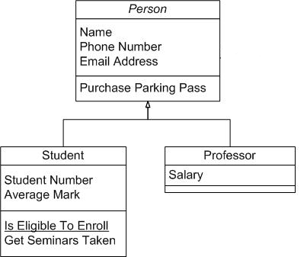
Inheritance
Is the ability to compose new abstraction from existing one
Promotes Re-usability
Base class – Super class: Class provide implementation
Derived class – Subclass: The class inheriting the implementation
Notes:
Promote re-use: Không phải bắt đầu từ đầu khi xây dựng một class mới. Có thể inherite các member data, method từ một class tương tự, và chỉ cần bổ xung các new feature
Base class – Super class – Parent class
Derived class – Sub class – Child class

Slide 14
Inheritance Inheritance – Extension
Vehicle
EngineStart()
SpeedChange()
Turn()
Stop()
Car
class Car: Vehicle {…}
// Car is a kind of Vehicle
// Car: derived/sub class
// Vehicle: base/super class
Vehicle v = new Car(); // OK
Vehicle v = new Plan(); // OK too
Vehicle v = new CombatPlan(); // OK
Plan p = new CombatPlan(); // OK
Car c = new Vehicle(); // error
Car c = new Plan(); // error
Plan
HighUp()
Down()
CombatPlan
Rotate()
Notes:
Object class is the base class of all class

Slide 15
Inheritance Advantages
Development model closer to real life object model with hierarchical relationships
Reusability – reuse public methods of base class
Extensibility – Extend the base class
Data hiding – base class keeps some data private
➔ derive class cannot change it
Protected Accessibility:
class Car{
protected int NumberWheels;
protected string MainColor;
protected int NumberRearPorts;
protected bool isWithUpperWindow;
protected int NumberSeats;
protected float CylinderVolume;
…
}
Notes:
All benefit apply to design, development and maintenance

Slide 16
Inheritance this, base, sealed class
class A{
protected int i;
protected int aMethod(int i){
this.i = i; // refer to current object
return i;
}
}
class B:A{
public int aMethod(int i){
return base.aMethod(i); // refer to parent
}
}
sealed class A{} // Inheritance forbidden
class B:A{} // error
static class C{}
class D:C{} // error: static implies sealed
Notes:
Abstract class : class do not represent anything concrete (cụ thể).
Class as “holder” for the shared/inherited attributes and behavior for derived classes.

Slide 17
Polymorphism
Polymorphism = multiple forms/many shape
By Definition:
1. The ability of objects to have different operations from the same interface.
2. The ability of different objects to respond in their own unique way to the same message
Implemented by:
Overloading
function overloading
operator overloading
Override
Notes:
Bổ xung hình vẽ

Slide 18
Polymorphism Overloading
To assign an operator, identifier or literal more than one meaning, depending upon the data types associated with it at any given time during program execution.
Two or more method with the same name, different signature
Example:
void display (int iX)
void display (float fY)
void display (char[] chC)
void display (char[] chC, int offset, int numchar)

Slide 19
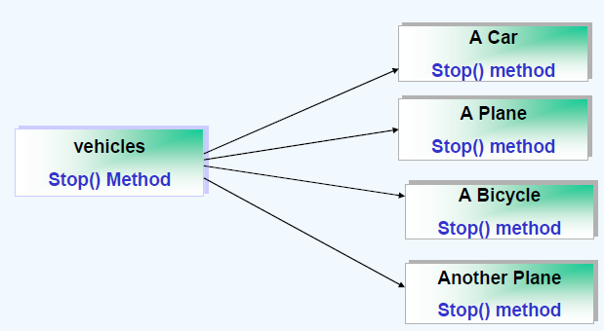
Polymorphism Overriding
Process of defining/re-defining the methods in the derived class
Methods have same name/same signature

Slide 20
Polymorphism Override - Feature Hiding
class A{
public int DefaultTempeture(){
return 25;
}
}
class B:A{
// object of type A cannot use the
// following method,
// the "new" keyword is optional
public new int DefaultTempeture(){
return 28;
}
}
A a = new B();
int x = a.DefaultTempeture(); // x = 25

Slide 21
Polymorphism Override - Feature Override
class A{
// virtual prevent for override
public virtual int DefaultTempeture(){
return 25;
}
}
class B:A{
// override: for predefined virtual only
// override: used for "deferred loading"
public override int DefaultTempeture(){
return 28;
}
}
A a = new B();
int x = a.DefaultTempeture(); // x = 28

Slide 22
Abstract Class & Interface Abstract Class 1/2
Class that contains one or more abstract methods
Abstract method: Method that has only declaration but no implementation.
Classes that extend abstract class make them concrete by implementing those abstract methods
Notes:
Abstract class : class do not represent anything concrete (cụ thể).
Class as “holder” for the shared/inherited attributes and behavior for derived classes.

Slide 23
Abstract Class & Interface Abstract Class 2/2
abstract class A{ // having at least one abstract method
// abstract method: no implementation
public abstract int DefaultTempeture();
// ordinal method: with implementation
public int TempIncStep(){
return 1;
}
}
class B:A{}
class C:B{}
public override int DefaultTempeture(){
return 25;
}
}
A a = new A(); // error: no infor about DefaultTempeture behavior
B a = new B(); // error: no infor about DefaultTempeture behavior
C a = new C(); // OK
A a = new C(); // OK
B a = new C(); // OK
Notes:
Abstract class has abstract method (and normal method too)
Abstract method has not implementation
Derived class has to implement ALL abstract inherited methods

Slide 24
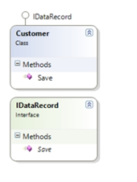
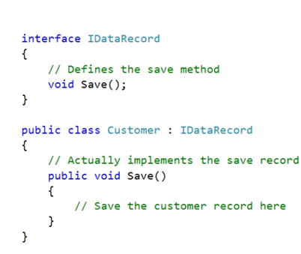
Abstract Class & Interface Interface 1/3
An interface defines a set of related functionality that can belong to one or more classes or structs.

Slide 25
Abstract Class & Interface Interface 2/3
An interface defines a contract
An interface is a type
Includes methods, properties, indexers, events
Any class or struct implementing an interface must support all parts of the contract
Interfaces provide no implementation
When a class or struct implements an interface it must provide the implementation
Interfaces provide polymorphism
Many classes and structs may implement a particular interface
Notes:
In scenarios where completely different objects need to support some kind of shared functionality like, let’s say, persist to XML, classes can implement interfaces that make them compatible with even if they don’t share the same base class. This provides most of the benefits of multiple class inheritance without the nasty side-effects that this usually brings.
Interface members are implicitly public and abstract.

Slide 26
Abstract Class & Interface Interface 3/3
interface IA{ // Interface is a special "abstract" class
int i; // Error: no member is allowed
int NewTempeture{get;} // OK
int DefaultTempeture(); // no abstract keyword, no access modifier,
// public access is fixed
int TempIncStep(){ // Error: No ordinal method allowed
return 1;
}
}
abstract class A:IA{} // abstract class can prevent the
// implementation of an interface
class B:IA{ // non-abstract class, when declared to use
// an interface, must implement all methods
// declared in the interface
public int DefaultTempeture(){return 1;}
}
class C:A{
public int DefaultTempeture(){return 2;}
}
IA a = new B(); IA b = new C(); // Interface is a type
Notes:
No normal method in interface
Declare variable of interface type
All feature are public

Slide 27
Abstract Class & Interface Multi Inheritance
Classes and structs can inherit from multiple interfaces
Interfaces can inherit from multiple interfaces
class A1{void a1(){}}
class A2{void a2(){}}
class A:A1, A2{}
// Error: "class multi inheritance" forbidden
interface IA1{void IA();}
interface IA2{void IA();}
class A:IA1, IA2{
// OK interface "multi interface" implementation
void IA1.IA(){} // All explicit implementation
void IA2.IA(){}
}
class B:IA1, IA2{
void IA(){} // one implementation for all interface
}
Notes:
Explicitly specify the Interface name when doubt in case of multi implementation

Slide 28
Abstract Class & Interface Abstract Class vs. Interface
Abstract: - Single inheritance - When base class change lead to the changing derived class.
Interface: - Multiple inheritance. - Flexible - Good for separate interface & implementation ( eg : plug-in programming)
More : http://liveonmyown.wordpress.com/2007/09/11/abstract-class-vs-interface/

Slide 29
Lesson Summary
Object-oriented systems describe entities as objects.
Objects are part of a general concept called classes
Abstraction
Encapsulation
Inheritance
Polymorphism
Object Oriented
Abstract class, Concrete class, Base class, Derive class, Attribute, Method,
Instance, Instantiation,

Slide 30


Slide 31
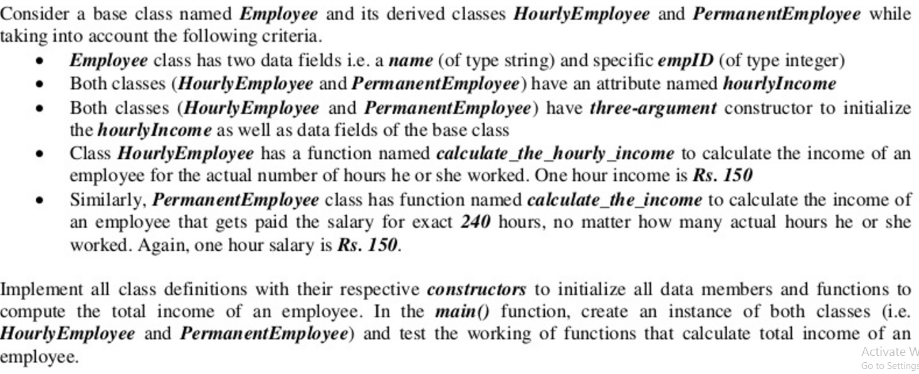
Practical Lab 1

Slide 32
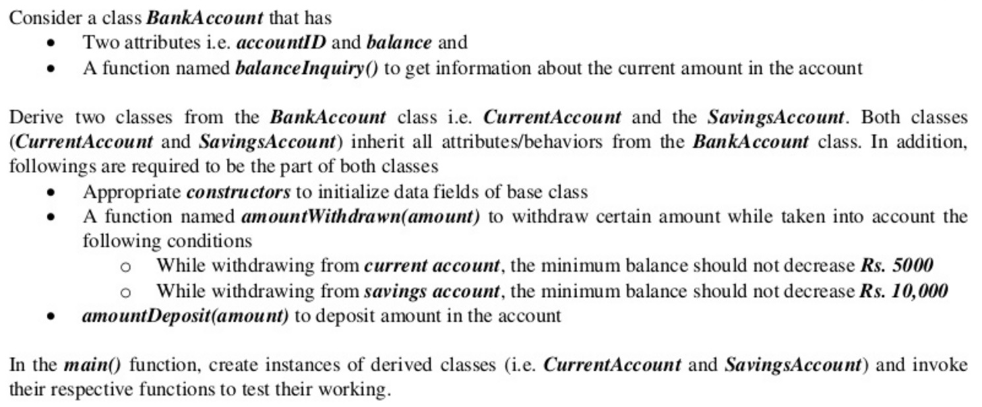
Practical Lab 2

Slide 33
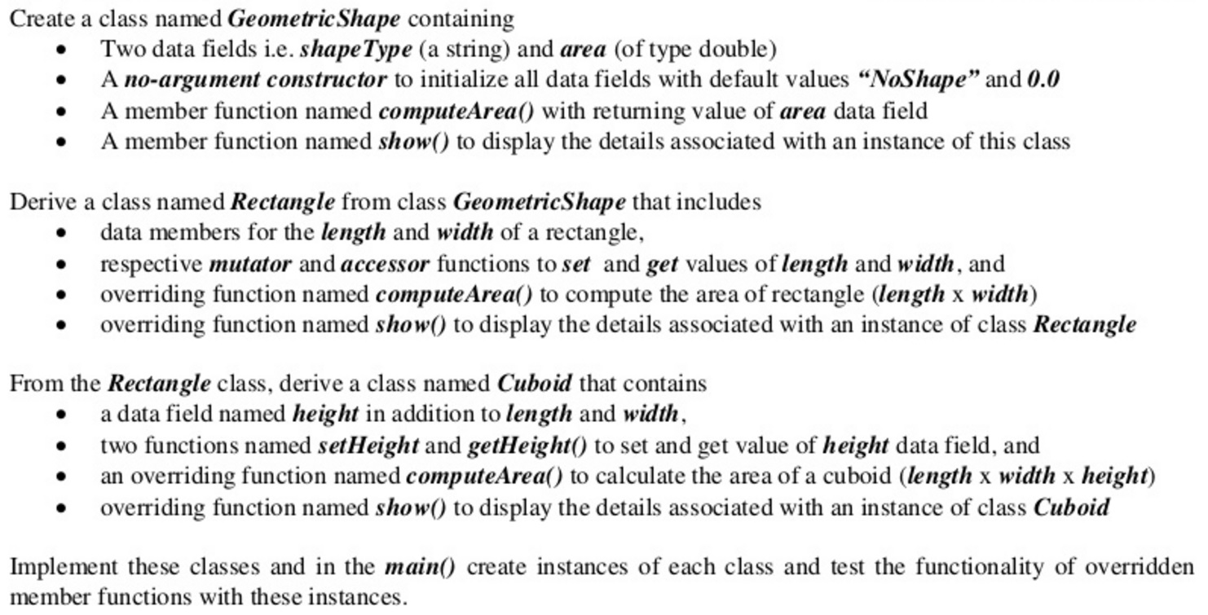
Practical Lab 3

